Slide 1
String and Scanner
Course Code: CSC 1205
Course Title: Object Oriented Programming 1
Dept. of Computer Science
Faculty of Science and Technology
Lecturer No: | 5 | Week No: | 3 | Semester: | Summer 19-20
Lecturer: | kawsur & kawsur@aiub.edu

Slide 2
Lecture Outline
Introduction to String
Implicit vs Explicit Construction
String Methods
String Equality
String is Immutable
Demonstration of String class
User Input using Scanner class

Slide 3
Introduction to String
Introduction
Strings, which are widely used in Java programming, are a sequence of characters.
In the Java programming language, strings are objects.
String objects are handled specially by the compiler.
String is the only class which has implicit instantiation.
The String class is defined in the java.lang package.
Strings are immutable. The value of a String object can never be changed.

Slide 4
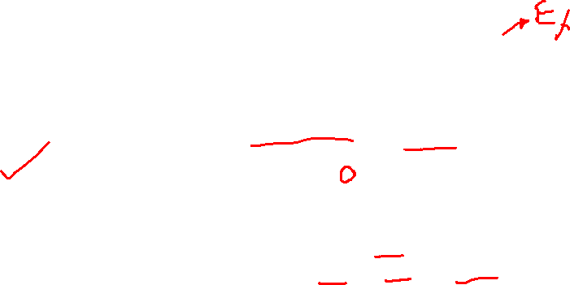
Introduction to String
Creating String Objects
In java objects are created using new keyword. So we can create string objects by using the new keyword and a constructor.
String greetings = new String(“Hello”);
However, String objects can be created implicitly.
String greetings = “Hello”;
String can also be created using the + operator. The + operator, when applied to Strings means concatenation.
int age = 20;
String message = “I am ” + age + “ years old”;

Slide 5
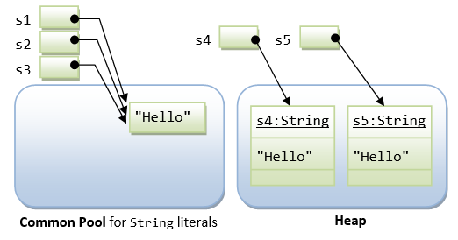
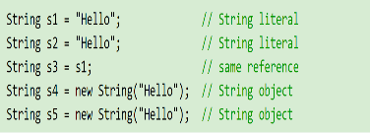

Implicit vs Explicit Construction
Difference between string objects vs string literals
As of we know, String can be constructed by either:
One, directly assigning a string literal to a String reference - just like a primitive.
Two, via the "new" operator and constructor, like any other classes.
Difference is:

Slide 6
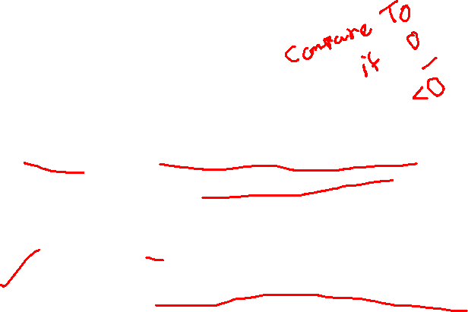
String Methods
Frequently used String Methods
The String class has many methods. The most used are:
length() - returns the number of characters in the String.
charAt() - returns the character at the specified index.
equals() - returns true if two strings have equal contents.
compareTo() -returns 0 if equal, Less than zero – if the invoking String is "less than” the other, Greater than zero - if the invoking String is "greater than" the other.
indexOf() - returns the index of specified String or character.
substring() -returns a portion of the String's text.
toUpperCase(), toLowerCase() - converts the String to upper- or lower-case characters.

Slide 7
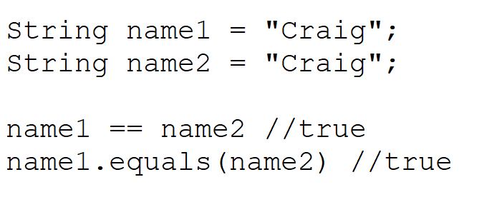
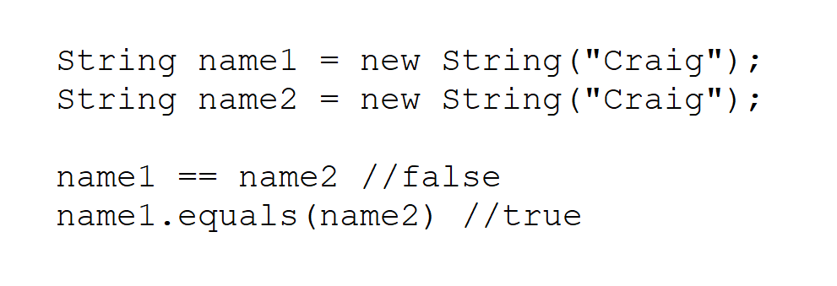

String Equality
Testing Strings for Equality
The == operator cannot be used to test String objects for equality.
Variables of type String are references to objects (i.e.. memory addresses)
Comparing two String objects using == compares their memory addresses. Two separate String objects may contain the equivalent text but reside at different memory locations.
Use the equals method to test for equality.

Slide 8

String is Immutable
String is immutable
Since string literals with the same contents share storage in the common pool, Java's String is designed to be immutable.
That is, once a String is constructed, its contents cannot be modified.
Otherwise, the other String references sharing the same storage location will be affected by the change, which can be unpredictable and therefore is undesirable.
If the contents of a String have to be modified frequently, use the StringBuffer or StringBuilder class instead. StringBuffer and StringBuilder is mutable.

Slide 9

Demonstration of String class
import java.lang.*;
public class StringDemo
{
public static void main(String args[])
{
String s1="HELLO java";
String s2= new String();
String s3 = new String("Hello");
String s4 = "Hello";
String s5 = new String("Hello");
String s6 = "Hello";
String s8=new String("JaVaClaSs");
System.out.println(s1.isEmpty());//false
System.out.println(s2.isEmpty());//True
System.out.println(s1.length());//10
System.out.println(s3.charAt(1));//e
System.out.println(s1.concat(s3));//HELLO JavaHello
System.out.println(s1);//
System.out.println(s3);//Hello
if(s3 == s5)//no
{
System.out.println("yes");
}
else
{
System.out.println("No");
}
if(s3.equals(s5))//yes
{
System.out.println("yes");
}
else
{
System.out.println("No");
}
String s7 = s1.substring(2,7);//begin index is inclusive end index is exclusive
System.out.println(s7);//LLO ja
System.out.println(s1);//HELLO javaHello
s1 = s1.substring(3,7);LO ja
System.out.println(s1); Lo ja
s8=s8.toLowerCase();
System.out.println(s8);javaclass
}
}

Slide 10

Scanner class
Java provides various ways to read input from the keyboard
The Scanner class is used to get user input
it is found in the java.util package
By the help of Scanner in Java, we can get input from the user in primitive types such as int, long, double, byte, float, short, etc.
To use the Scanner class, create an object of the class and use any of the available methods found in the Scanner class documentation.

Slide 11

Scanner class methods
Method | Description
nextBoolean() | Reads a boolean value from the user
nextByte() | Reads a byte value from the user
nextDouble() | Reads a double value from the user
nextFloat() | Reads a float value from the user
nextInt() | Reads a int value from the user
nextLine() | Reads a String value from the user
nextLong() | Reads a long value from the user
nextShort() | Reads a short value from the user

Slide 12

Scanner class demonstration
import java.util.Scanner;
class MyClass {
public static void main(String[] args) {
Scanner myObj = new Scanner(System.in);
System.out.println("Enter name, age and salary:");
// String input
String name = myObj.nextLine();
// Numerical input
int age = myObj.nextInt();
double salary = myObj.nextDouble();
// Output input by user
System.out.println("Name: " + name);
System.out.println("Age: " + age);
System.out.println("Salary: " + salary);
}
}

Slide 13
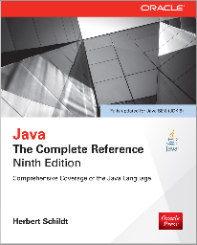
Books
Java The Complete Reference- Ninth Edition by Herbert Schildt

Slide 14
References
https://docs.oracle.com/javase/tutorial/

